Slide 1
Web Security
Kevin Jones HRNUG 2015

Slide 2
About Me
Security Architect at Thycotic in Washington, DC
Presentation / code available on github.com/vcsjones
Apache 2.0 / CC-BY license.

Slide 3
The implied feature
Many features are implied but never asked for
Performance
Usability
Security
Only asked for when it isn’t there

Slide 4
Why Security Is Hard
Constantly changing landscape
Extremely unpredictable
Political, to an extent

Slide 5
Start Simple
Basics aren’t hard
When done right, shouldn’t severely impact business needs
Build a plan.

Slide 6
An Actionable Plan
Write something down
Review monthly
Then every half year
Adjust review as needed

Slide 7
Basics never go away
Basics still an attackers most likely choice
Automat-able
Widely available
Still effective

Slide 8
Humans
Security is almost always in inconvenience.
Actively try to defeat security
Push back harder the harder you push.

Slide 9
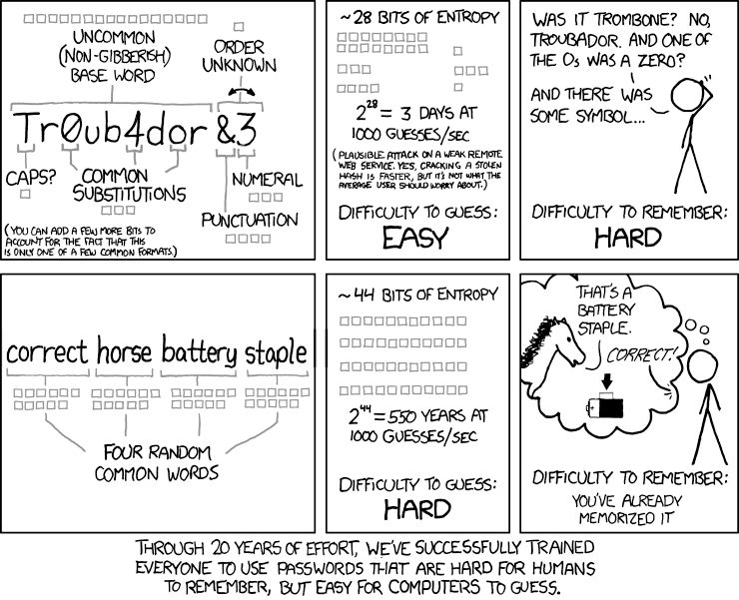
XKCD
Of much debate

Slide 10
Clickjacking
Fooling a user into clicking something other than what they intended.
Easily done with frames.

Slide 11
Prevention
X-Frame-Options HTTP Header.
DENY
SAMEORIGIN
ALLOW-FROM
Technically deprecated (CSP 2 supersedes it)
Practically, CSP 2 doesn’t have widespread support.
Later versions of MVC do this out of the box.

Slide 12
Cross Site Scripting
Potentially allows execution of scripts for another user.
Attack vectors: login pages, credit card pages.
Malicious script payloads that exploit browsers.
Used to execute other attacks, like clickjacking.

Slide 13
Prevention
Forbid entry of HTML, if possible.
Escape everything written to the page.
MVC does a good job of this
Use <%: %> in Web Forms
Use Content-Security-Policy

Slide 14
Content Security Policy
Applies to scripts, images, fonts, CSS, frames, etc.
Whitelist resource sources
New - not all browsers have proper support (IE)
IE only supports the sandbox directive.

Slide 15
Inline Scripts
Should be avoided
For security and performance
Are a natural need of many web applications
‘unsafe-eval’ and ‘unsafe-inline’ allow it.

Slide 16
CSP Hashes and Nonces
Header may include hashes of inline scripts
Unwieldy, HTTP header bloat
Header may include a random nonce to whitelist scripts
Better solution, not well adopted
Nonces do not help if attacker can influence script bodies.

Slide 17
Fonts & images: Why?
Some fonts in Windows are drawn by the kernel (MS13-052, 53, & 54)
Images can be used for tracking.
Images can be used for social engineering.

Slide 18
Reporting
Content-Security-Policy →Content-Security-Policy-Report-Only
Reports errors to console without blocking them
Useful for testing in production

Slide 19
Adoption
 | Firefox | Chrome | IE | Spartan
CSP 1.0 | YES | YES | NO | YES
CSP 2.0 | YES (35+) (37+ EXP) | YES (32+) | NO | UNCOMMITED
X-Frame-Options | YES | YES | YES | YES

Slide 20
SQL Injection
User input is interpreted as part of a SQL query.
Can be used to retrieve data unmeant to be seen
Or write to the database

Slide 21
Prevention
Parameterize SQL queries
Use different SQL accounts for read / writes and lock down permissions (least privilege principle)

Slide 22
GET Mutation
Similiar to clickjacking
Use social engineering to get someone to click a link into an authenticated system
Web Services are often overlooked.
Attempts to be RESTful and use GETs leave security holes

Slide 23
Prevention
Data mutation should be a POST, PUT, PATCH, etc HTTP verb.

Slide 24
Client Validation Only
Data is validated for correctness on the browser
Attackers can bypass the browser and submit any data

Slide 25
Solution
Validation should always be done on the server side, in addition to the client.
Unobtrusive validation makes that easy in MVC.

Slide 26
Bad Cryptography
Cryptography itself has rarely been broken.
Most flaws occur due to developer misuse of cryptographic primitives
Hand-rolled
Overly complicated / getting fancy
Misunderstandings

Slide 27
Prevention
Use a framework and well-known primitives
Get it audited by a 3rd party Do that even if you do know what you are doing

Slide 28
DIY Password Storage
Use a KDF, like bcrypt or PBKDF2
Don’t hash yourself with SHA-1 or SHA-2.

Slide 29
DIY Password Generation
Generated passwords cannot be truly random.
Use a proper RNG (System.Random is not)

Slide 30
Questions?

